Slide 1

SIMULATION AND PROBABILITY
DAVID COOPER
SUMMER 2014

Slide 2
Simulation
As you create code to help analyze data and retrieve real numbers from input response, you may be asked about the accuracy of your analysis
Most experimental results are indirect methods at getting to the underlying physical phenomenon controlling the system
While you can compare your collected results to theoretical results everything is still grounded by the accuracy of the theoretical answer
Knowing how to simulate experimental data allows for the true answer to be known, which makes testing the accuracy much easier

Slide 3
Variability
In the real world very few things are measurable as constants. Most have some degree of variability to them
For many of the events that we study we have some idea of the variability of the system
When creating a model system for testing you first start with the true values and then add variability from different probability distributions to account for the various experimental parameters that affect real signals
There will often be more than one source of variability in a system that you will need to account for

Slide 4
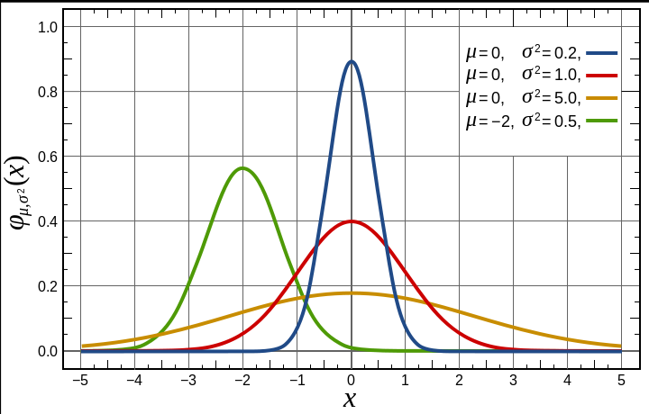
Probability Distribution Function
Probability Distribution Functions or pdfs display the probability that a random variable will occur at a specific value
The total sum or integrand of the entire distribution will always equal to 1
To create a probability distribution for a given set of data you can histogram the data along the variable that you want to measure the probability.
Fitting the histogram to the desired pdf will allow you to extract the parameters for that type of distribution

Slide 5
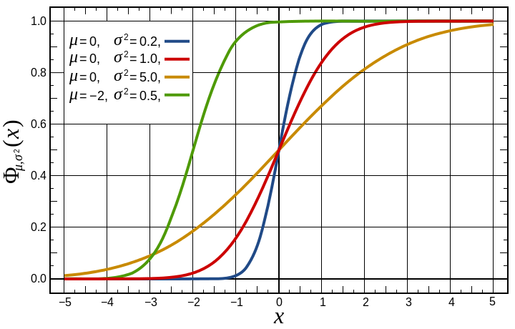
Cumulative Distribution Function
The Cumulative Distribution Function is the integrated pdf and shows the probability of a random variable being equal to or less than a specific value
While less intuitive than the pdf the cdf offers some advantages for data analysis
Because the cdf is an accumulative function there is no need to histogram a data set before fitting avoiding the error that binning the data can cause
Instead simply sort the data from low to high incrementing by 1/n at each point creates a curve to which the cdf can be fit to

Slide 6
Discrete vs Continuous
Probability distributions can be broadly categorized into two types
Discrete distributions describe processes whose members can only obtain certain values but not those in between
Examples of discrete probabilities would be the result of coin toss or the number of photons emitted
Continuous distributions refer to processes that come from the full range of values
Example of continuous probabilities would be the arrival time of a photon

Slide 7
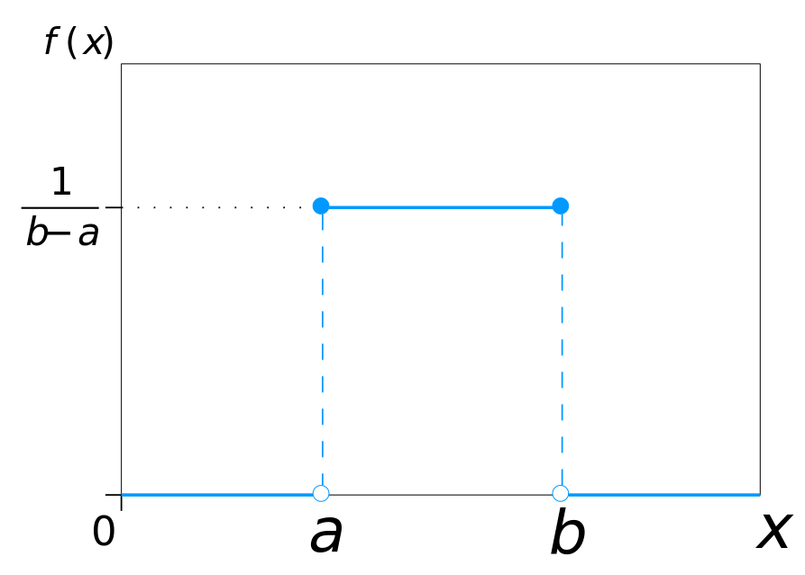
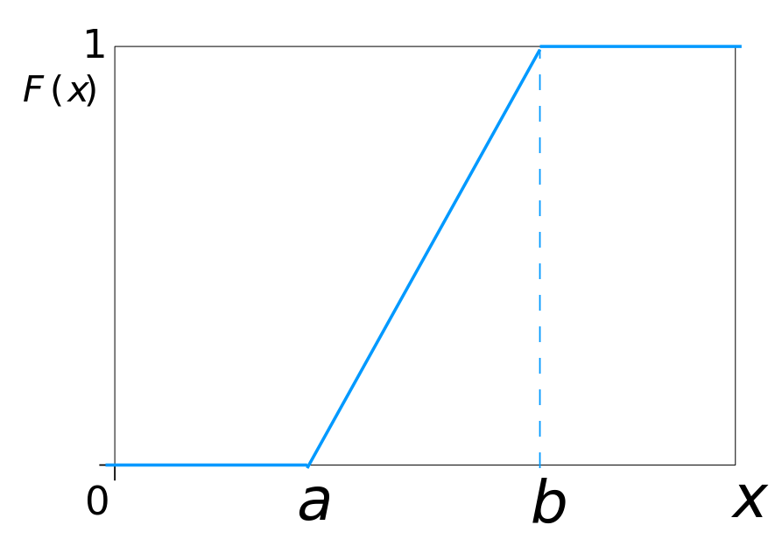
Common Distributions: Uniform
The most basic distribution is the uniform distribution which sets all probabilities of possible values equal to each other
Uniform variables can either be discrete or continuous
In MATLAB the command for calling the pdf and cdf of a uniform distribution are unidpdf(), unidcdf(), unifpdf(), and unifcdf()
  >> unidcdf(x,N)
  >> unifpdf(x,a,b)
PDF CDF

Slide 8
Common Distributions: Normal
Perhaps the most common distribution is the normal or gaussian distribution
The normal distribution distribution functions can be called with the normpdf() and normcdf() functions
  >> normcdf(x,mu, sigma)
  >> normpdf(x)
PDF CDF

Slide 9
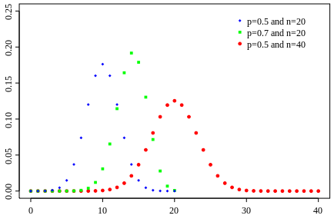
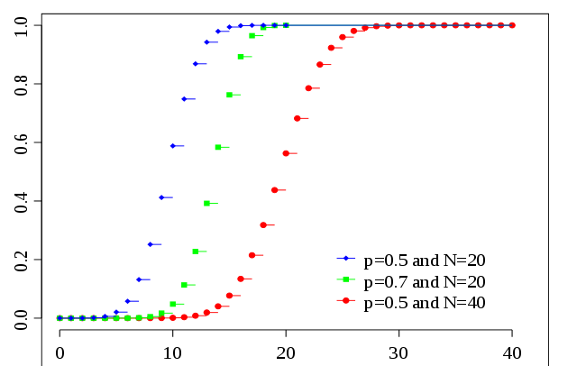
Common Distributions: Binomial
The binomial distribution is used for processes that have a success or fail probability and is useful for determining the total probable number of successes
The MATLAB call for the pdf and cdf for the binomial distributions are
  >> binocdf(x,N,p)
  >> binopdf(x,N,p)
PDF CDF

Slide 10
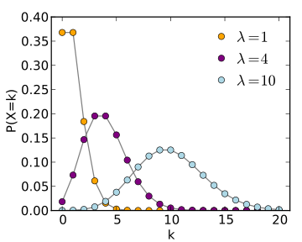
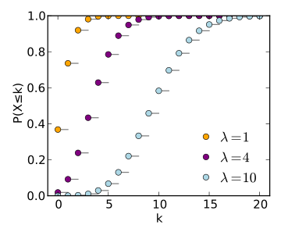
Common Distributions: Poisson
The Poisson distribution is a common distribution for signal response from electronic sensors
The MATLAB call for the pdf and cdf for the binomial distributions are
  >> poisscdf(x,lambda)
  >> poisspdf(x,lambda)
PDF CDF

Slide 11
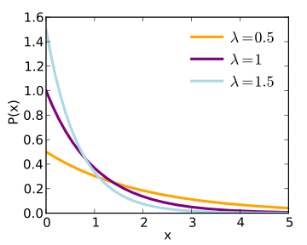
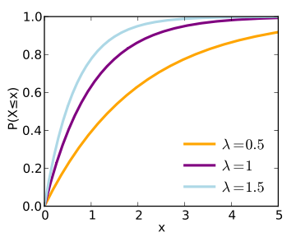
Common Distributions: Exponential
The exponential distribution helps determine the time to the next event in a Poisson process
The MATLAB function calls for the pdf and cdf of the exponential distributions are
  >> expcdf(x,lambda)
  >> exppdf(x,lambda)
PDF CDF

Slide 12
Central Limit Theorem
The main reason that the normal distribution is so common is because of the tendency for data distributions to approach it
The Central Limit theorem states that any well defined random variable can be approximated with the normal distribution given a large enough sample size
This works because as you take the mean or sum of a random distribution and plot the occurrence of that descriptor for a well defined independent distribution the overall distribution of that descriptor will be a normal distribution
This is incredibly useful for data analysis as it will let almost any process that has enough data points collected be able to be represented by a normal distribution

Slide 13
Building the Model
As we have used before MATLAB has prebuilt functions that can mimic randomness
For all of the described functions replacing cdf or pdf with rnd will generate a random variable with the input distribution
The easiest way to generate a model that contains multiple variabilities would be to create randomized vectors of the same length and add them together

